Slide 1

Lab Data Streaming
6/10/2019
malefe@microsoft.com

Slide 2
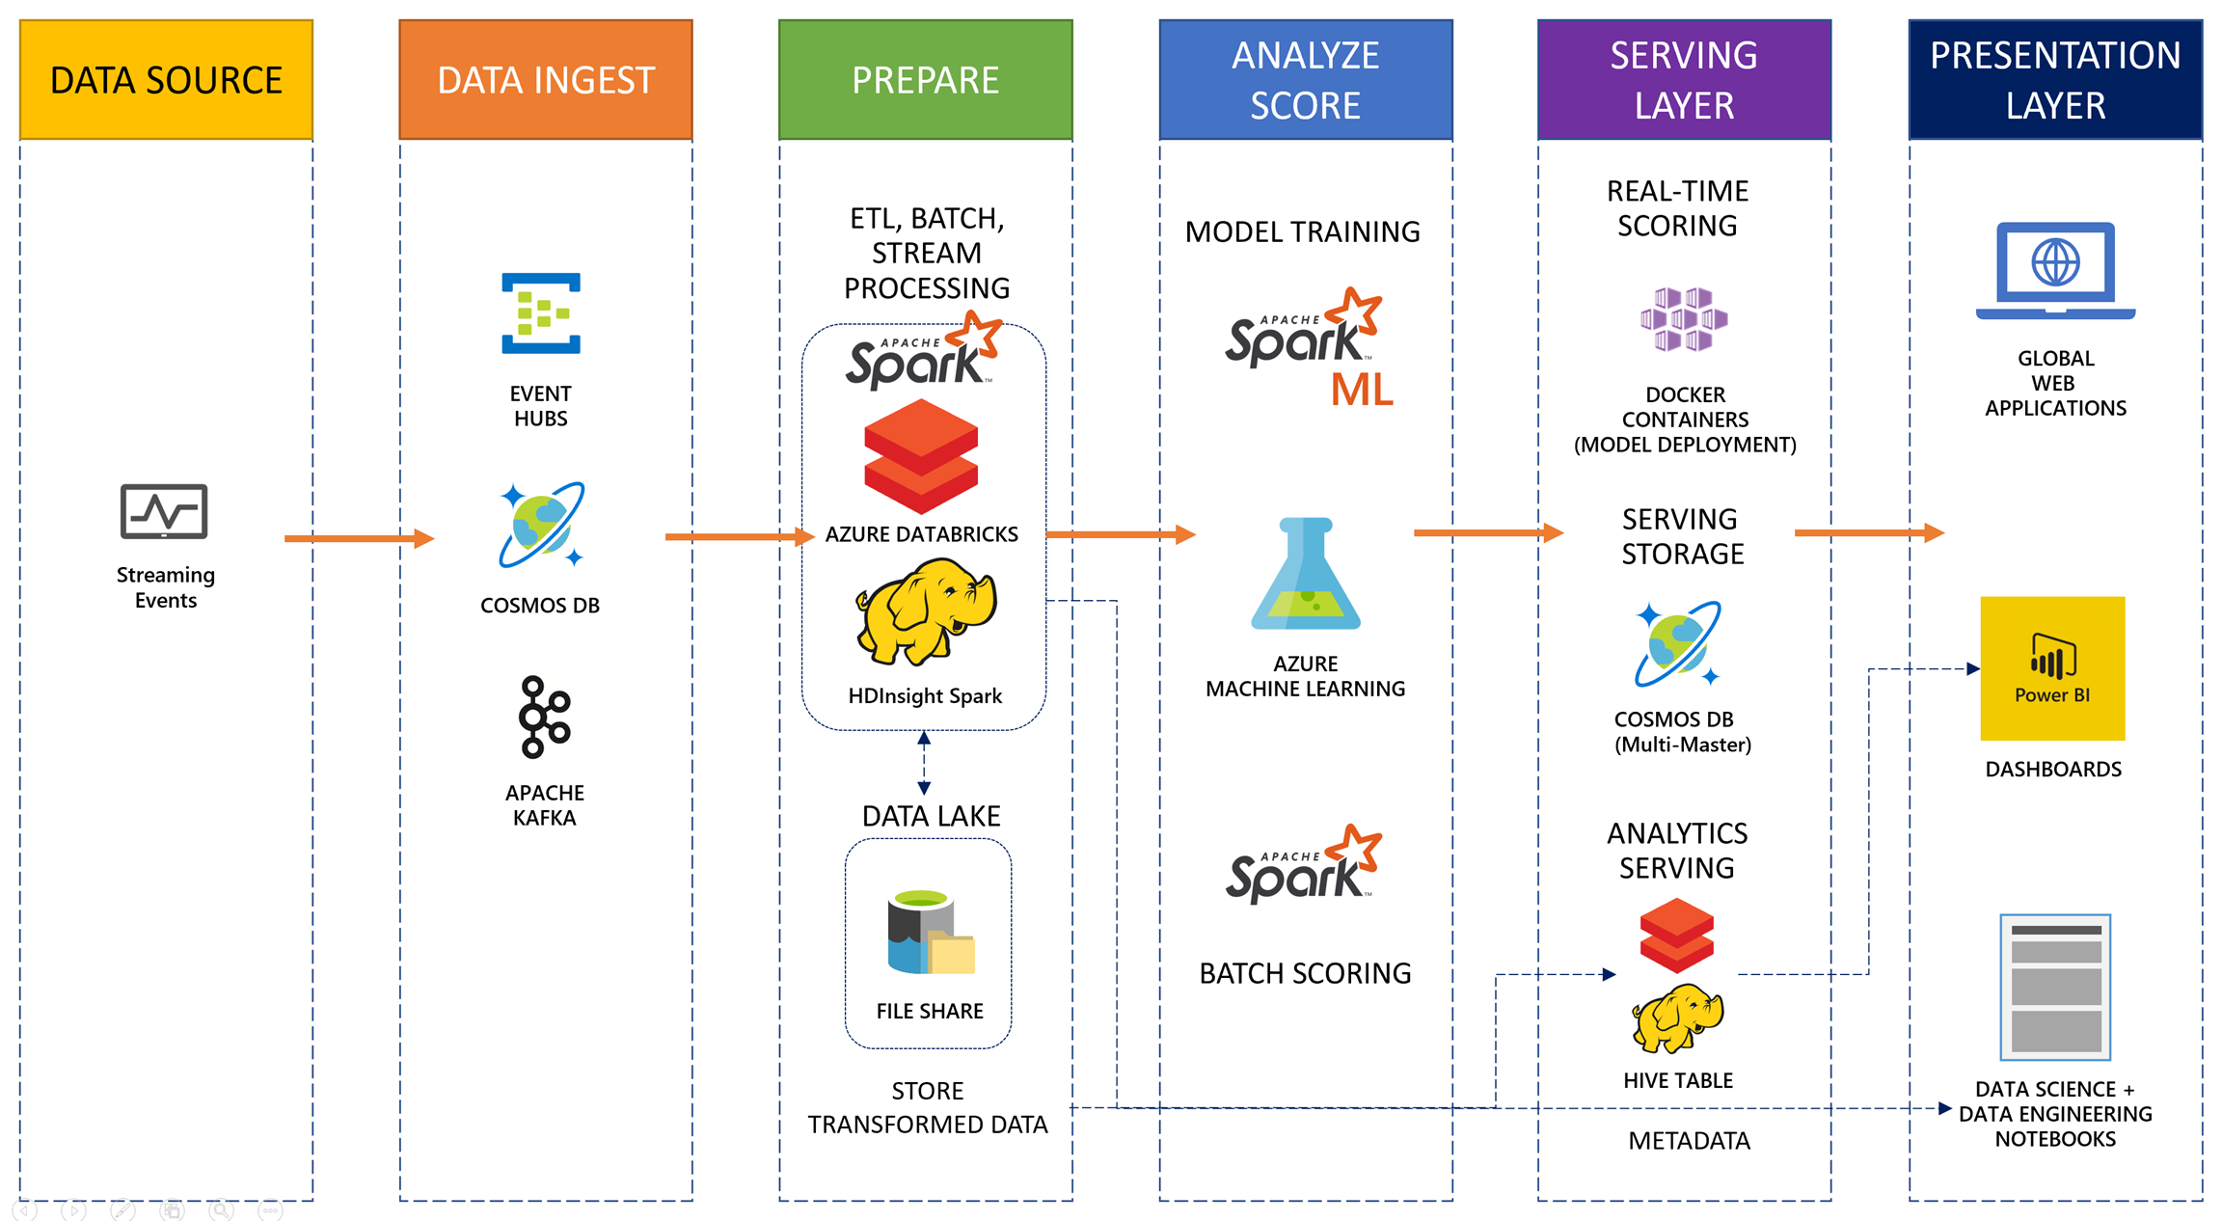
Azure – Typical Analytics Streaming Architecture

Slide 3
Goal
Goal of this workshop will be to build an Azure infrastruture full PaaS oriented and create a kind of “hello world” streaming application in Azure.
Something like: simple producer -> to Event Hubs -> to Databricks -> Datalake -> SQL Data Warehouse.

Slide 4

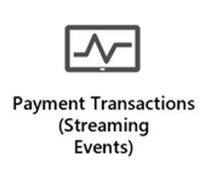


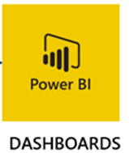



Lab Architecture
Data Ingest
Data Processing
Azure Event Hub
Azure Databricks
Azure Cosmos Db
DB Delta
Data Lake
Serving
Cold Data
Refined data
Polybase
Azure Data Lake Storage
Azure Sql Data Warehouse
Azure Key Vault

Slide 5


Architecture with ML
Global Distributed Model Serving
Real-Time Scoring
Model training
Model Deploy
Azure Kubernetes Service (Web Service)
Azure Databricks
(Spark ML)
Data Ingest
Global Web App
Data Processing
Serving Storage
Suspicious
Transactions
Azure Event Hub
Azure Databricks
Azure Cosmos Db
Azure Cosmos Db
DB Delta
Data Lake
Serving
Cold Data
Refined data
Azure Data Lake Storage
Azure Sql Data Warehouse
Azure Key Vault
Polyase
Notes:
The solution begins with the payment transaction systems writing transactions to Azure Cosmos DB. Using the built-in change feed feature in Cosmos DB, the transactions can be read as a stream of incoming data within an Azure Databricks notebook, using the `azure-cosmosdb-spark` connector, and stored long-term within an Azure Databricks Delta table backed by Azure Data Lake Storage. The Delta tables efficiently manage inserts and updates (e.g., upserts) to the transaction data. Tables created in Databricks over this data can be accessed by business analysts using dashboards and reports in Power BI, by using Power BI's Spark connector. Alternately, semantic models can be stored in Azure Analysis Service to serve data to Power BI, eliminating the need to keep a dedicated Databricks cluster running for reporting.
Data scientists and engineers can create their own reports against Databricks tables, using Azure Databricks notebooks.
Azure Databricks also supports training and validating the machine learning model, using historical data stored in Azure Data Lake Storage. The model can be periodically re-trained using the data stored in Delta tables or other historical tables. The Azure Machine Learning service is used to deploy the trained model as a real-time scoring web service running on a highly available Azure Kubernetes Service cluster (AKS cluster). The trained model is also used in scheduled offline scoring through Databricks jobs, and the "suspicious activity" output is stored in Azure Cosmos DB so it is globally available in regions closest to customers through their web applications.
Finally, Azure Key Vault is used to securely store secrets, such as account keys and connection strings, and serves as a backing for Azure Databricks secret scopes.

Slide 6
Lab Instructions
https://github.com/MatthieuLefebvre/Streaming---Real-Time-Advanced-Analytics/blob/master/README.md

Slide 7

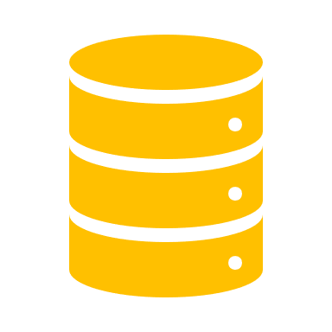
Preferred solution
Data ingest
Payment transactions can be ingested in real-time using Event Hubs or Azure Cosmos DB.
Factors to consider are rate of flow (how many transactions/second), data source and compatibility, level of effort to implement, and long-term storage needs.
Both service options are highly capable and guarantee event ordering per-partition. As such, it is important how you partition your data with either service.
Cosmos DB can serve as raw storage and provide streaming through its change feed. It also has very flexible message retention by setting the time-to-live (TTL) value for ingest documents so they automatically delete after any desired period of time, allowing for re-processing and saving in storage costs.
Notes:
What are your recommended options for ingesting payment transaction events as they occur in a scalable way that can be easily processed while maintaining event order with no data loss?
- There are a couple of options in Azure for ingesting real-time streaming payment transactions. Which one you choose will depend on various factors, including the rate of flow (how many transactions/second), data source and compatibility, level of effort to implement, and long-term storage needs.
Event Hubs is a Big Data streaming platform and event ingestion service, capable of ingesting millions of events per second. It supports multiple consumers (event processors) and is automatically scalable. Event Hubs is a good candidate for this architecture for the following reasons:
Fully managed PaaS with little configuration or management overhead.
Highly scalable to process millions of events per second. Use the Auto-inflate feature to automatically scale the number of throughput units to meet usage needs.
Contains an optional Apache Kafka endpoint, allowing for event processing from existing Kafka-based applications. This also allows for simple integration with Apache Spark clusters, such as those hosted in Azure Databricks.
Simultaneously supports real-time and batch processing through Event Hubs Capture. This feature allows one to easily capture and store all events in their raw form to either Azure Blob storage or Azure Data Lake Store for long-term retention and micro-batch processing.
Event publishers (systems sending payment transaction data) can publish events using HTTPS, AMQP 1.0, or Apache Kafka 1.0 and above.
Event consumers can process streams using .NET, Java, Python, Go, or Node.js.
Azure Cosmos DB change feed outputs a sorted list of documents that were changed in the order in which they were modified or inserted. Like Event Hubs, the change feed output can be distributed across one or more consumers for parallel processing. Azure Cosmos DB change feed is a good candidate for this architecture for the following reasons:
Fully managed PaaS with little configuration or management overhead.
Cosmos DB is highly scalable, and is already being used to store pre-scored fraud data.
An Apache Spark connector is available, allowing Azure Databricks clusters to directly access the change feed with very little code.
Cosmos DB with change feed enabled acts as both a raw data store for batch processing and stream processing.
Event publishers can publish events to Cosmos DB using .NET, Java, Node.js, and Python, using a number of APIs, such as SQL, Cassandra, MongoDB, Gremlin, and Azure Table Storage. However, please note that the change feed feature can only be used by the SQL and Gremlin APIs. Woodgrove will be using the SQL API, so they will be able to use the change feed feature.
Cosmos DB is globally accessible across many Azure regions, bringing it closer to distributed event publishers and consumers.
In a multi-region Azure Cosmos account, if a write-region fails over, change feed will work across the manual failover operation and it will be contiguous.
Another decision point for using Cosmos DB for ingestion, is that it offers flexible message retention through its time-to-live (TTL) settings. This value can be set at the container level by applying a TTL value for all documents within, or on individual messages as they are sent. This optimization helps save in storage costs by automatically expiring (deleting) the documents after the specified period of time. For instance, you can set the TTL to 60 days to allow Woodgrove Bank to keep the streaming data available for that amount of time so they can reprocess in Azure Databricks, or query the raw data within the collection as needed.
Event Hubs has a similar feature called message retention. You can set the value between one and seven days, or a maximum of four weeks if you contact Microsoft support. Setting the TTL for documents saved to Cosmos DB individually for any length of time desired (even beyond 7 days) is an advantage Cosmos DB has over Event Hubs when used for ingesting streaming data.

Slide 8
Preferred solution
Data ingest
Event Hubs can provide streaming data and can automatically store raw data in Blob storage or ADLS, using Event Hubs Capture.
Cosmos DB likely easier to integrate because we are already writing payment transactions to a database.
Cosmos DB also has the advantage of operating at a global scale, whereas with Event Hubs, you have to host multiple instances to accomplish this.
What is your recommended solution ?
Notes:
Of the ingest options you identified previously, which would you recommend for the scenario?
- Both services are certainly capable of acting as the ingestion service. They both support a high rate of flow, and both have options for long-term storage needs. However, Event Hubs requires an extra step for long-term storage, which is handled through Event Hubs Capture, whereas Cosmos DB already acts as this storage for raw data. Level of effort to implement tilts the scale toward Cosmos DB since transactional data is already being written to a database, those payment processors can be updated to also write to Cosmos DB or switch over to Cosmos entirely if it makes sense. Event Hubs requires adding an event service to their architecture and learning how to use it from their current systems.
- Apart from addressing the primary decision factors above, another strong consideration for choosing Cosmos DB is the issue of data sovereignty. Since Woodgrove Bank has customers around the world, some countries in which they operate may not allow data to be written and stored in a different country. Since Cosmos DB makes it easy to distribute data on a global scale, it may be required to have separate collections per region to meet regulatory requirements. This limitation can be worked around with Event Hubs, but the level of effort to do so may not be worth it in the long run. In this case, we will recommend Azure Cosmos DB for ingest.

Slide 9

Preferred solution
Data pipeline processing
Use Azure Databricks, a platform that can process streaming and batch data, as well enable data science, data engineering, and support development needs.
Features it provides over top of standard Apache Spark include:
AAD integration and RBAC
Collaborative features such as workspace and git integration
Run scheduled jobs for automatic notebook/library execution
Integrates with Azure Key Vault
Train and evaluate machine learning models at scale
Notes:
If you would like a unified way to process both streaming data and batch data on a platform that can also support their data science, data engineering, and development needs. Which platform would you recommend, and why?
- Recommended platform is Azure Databricks. Built on Apache Spark and provides unified way of working with big data, whether you process it real-time as it arrives or in batches, Apache Spark provides a fast and capable engine that also supports data science processes, like machine learning and advanced analytics. Built as a joint effort by the team that started Apache Spark and Microsoft, Azure Databricks provides data science and engineering teams with a single platform for Big Data processing and Machine Learning.
There are a lot of features Azure Databricks offers over top of standard Spark installations. The key features that make this a good choice for Woodgrove Bank are:
Integrates with Azure Active Directory for single sign-on and RBAC in certain scenarios.
Contains collaborative features such as the workspace that contains both private and shared folders, integrated change tracking of notebooks and integration with git source control systems like GitHub, and granular user and role-based permissions.
It is possible to start and stop clusters either manually or automatically, based on usage.
Supports running scheduled jobs for executing notebooks and libraries on a schedule.
Integrates with Azure Key Vault, which serves as a backing store for secrets within Azure Databricks, including automatic redaction of those secrets when users attempt to output them in a notebook.
Includes Databricks Delta, which supports features Woodgrove Bank is looking for, such as the ability to upsert data into tables, optimize data storage, and simultaneously read data from tables which are being written to by streaming and batch processes.
Join disparate data sets found in data lakes.
Train and evaluate machine learning models at scale.

Slide 10
Preferred solution
Data pipeline processing
Databricks Delta Lake tables are Spark tables with built-in reliability and performance optimizations.
Supports batch and streaming with additional features:
ACID transactions: multiple writers simultaneously modify data
DELETES/UPDATES/UPSERTS: Writers can modify data set without interfering with jobs reading the data set
Automatic file management: Data access speeds up by organizing data into large files that can be read efficiently
Statistics and data skipping: Reads are 10-100x faster when statistics are tracked about data in each file, avoiding irrelevant information
Notes:
The big data systems Woodgrove Bank used in the past were only able to append new data to the end of existing data sets. This meant each time they had update, they would actually create a duplicate row containing the changed data and then have to author queries to merge those rows so that they had a clean view of the current state of the data. How will your chosen platform cope with this challenge?
- Use Databricks Delta. Databricks Delta is a Spark table with built-in reliability and performance optimizations.
- You can read and write data stored in Databricks Delta using the same familiar Apache Spark SQL batch and streaming APIs you use to work with Hive tables or Databricks File Store (DBFS) directories. Databricks Delta provides the following functionality:
ACID transactions - Multiple writers can simultaneously modify a data set and see consistent views.
DELETES/UPDATES/UPSERTS - Writers can modify a data set without interfering with jobs reading the data set.
Automatic file management - Data access speeds up by organizing data into large files that can be read efficiently.
Statistics and data skipping - Reads are 10-100x faster when statistics are tracked about the data in each file, allowing Delta to avoid reading irrelevant information.

Slide 11

Preferred solution
Data pipeline processing
Azure Databricks can connect to both Event Hubs and Cosmos DB, using Spark connectors for both.
Use Spark Structured Streaming to process real-time payment transactions into Delta Lake tables.
Be sure to set a checkpoint directory on your streams. This allows you to restart stream processing if the job is stopped at any point.
Store secrets such as account keys and connection strings centrally in Azure Key Vault, then set that as the source for secret scopes in Azure Databricks. Secrets are [REDACTED].
Notes:
How will your chosen data processing platform connect to and process data from your chosen data ingest solution for streaming data?
- Whether you have chosen to ingest your data using Azure Cosmos DB with change feed, or Event Hubs, you can connect to either of these directly from Spark. For Cosmos DB, use the azure-cosmosdb-spark connector, which lets you easily read to and write from Azure Cosmos DB via Spark DataFrames in either Python or Scala. For Event Hubs, either use the azure-eventhubs-spark library, or enable Kafka on your event hub and use the Spark-Kafka adapter (supports Kafka v2.0+), available as of Spark v2.4.
- Because the payment transactions will be arriving in real time, you will want to use Spark Structured Streaming to process the data. Think of a stream of data as a table to which data is continuously appended. In streaming, the problems of traditional data pipelines are exacerbated. Specifically, with frequent meta data refreshes, table repairs and accumulation of small files in intervals measured in seconds or minutes. Many small files result because data may be streamed in at low volumes with short triggers. Databricks Delta is uniquely designed to address these needs.
What configuration would you need to apply to your solution to allow it to restart any stream processing in the case the job is stopped?
- When defining a Delta streaming query, one of the options that you need to specify is the location of a checkpoint directory.
- Please note, if you do not have a checkpoint directory, when the streaming job stops, you lose all state around your streaming job and upon restart, you start from scratch.
What specific secrets will their processing solution might want to store? How would they securely store and access those secrets?
- Specific secrets that they may need to be accessed by Azure Databricks are account names and keys for Azure Data Lake Storage, Cosmos DB connection strings or access keys, and Azure Machine Learning account keys.
- To securely store these secrets, use Azure Key Vault, in addition to Key Vault-backed secret scopes within Azure Databricks. Azure Key Vault provides a service that allows you to securely centralize application secrets. The benefit of it being a centralized store of secrets, is that you only need to define those secrets, like connection strings or account keys, in one place which can be accessed by several Azure services as well as custom applications.
- Azure Databricks has two types of secret scopes: Key Vault-backed and Databricks-backed. These secret scopes allow you to store secrets, such as database connection strings, securely. If someone tries to output a secret to a notebook, it is replaced by [REDACTED]. This helps prevent someone from viewing the secret or accidentally leaking it when displaying or sharing the notebook.

Slide 12


Preferred solution
Long-term data storage
Use Azure Data Lake Storage Gen2 (ADLS Gen2) as the underlying long-term file store for Delta Lake tables.
ADLS Gen2 is specifically optimized for Big Data workloads.
Delta tables can be accessed by Power BI through a JDBC connector.
Delta Lake can compact small files together into larger files up to 1 GB in size using the OPTIMIZE operator. This can improve query performance over time.
Define file paths in ADLS for query, dimension, and summary tables. Point to those paths when saving to Delta Lake.
Notes:
As incoming data is processed, refined, and scored, all of the transactions need to be persisted to long-term storage for analysis, model training and validation, and reporting. This storage needs to handle long-term growth, be fast enough to rapidly ingest new data while simultaneously handling reads against the same data set without interference, and act as a reliable data source for dashboards and reports. Which is your recommended long-term data storage solution, keeping in mind its role within your selected data pipeline processing platform?
- Although our proposed solution uses Databricks Delta to store data within a Delta table, we still need to select the appropriate storage service it uses under the covers. For this, use Azure Data Lake Storage Gen2 (ADLS Gen2).
- With Databricks Delta managing the files stored within ADLS, the files will be optimized through re-indexing and combining numerous small files into fewer, read-friendly large files. Other enhancements provided by Delta allow for simultaneously handling reads and writes against the same data set without interference. The Delta table can be accessed by BI dashboard and reporting services that support reading Hive tables, such as Power BI.
How do you ensure your data is continuously optimized within your chosen long-term data storage solution, given the requirements to store inserts, updates, and deletes while avoiding generating very small, un-optimized files?
- Historical and new data is often written in very small files and directories. This will especially be the case when dealing with real-time payment transaction data. The result is that a query on this data may be very slow due to network latency or volume of file metadata. The solution is to compact many small files into one larger file. Databricks Delta does this using the OPTIMIZE operation. Small files are compacted together into new larger files up to 1GB. The 1GB size was determined by the Databricks optimization team as a trade-off between query speed and run-time performance.
- OPTIMIZE is not run automatically and can take some time to complete. Set up a schedule to periodically run and observe results.

Slide 13

Preferred solution
Dashboards and reporting
Connect to Databricks Delta tables from Power BI to allow analysts to build reports and dashboards.
The connection can be made using a JDBC connection string to an Azure Databricks cluster. Querying the tables is similar to querying a more traditional relational database.
Data scientists and data engineers can use Azure Databricks notebooks to craft complex queries and data visualizations.
Notes:
business analysts would like to have a set of dashboards they can monitor that provide real-time views of fraud trends at a global scale. Thinking back to how your proposed solution provides a set of summary (gold) tables containing business-level aggregates, what do you propose using to meet this requirement? Be specific about how this solution will be put in place and which features it supports.
- PowerBI can query any tables created in Azure Databricks. This connection is facilitated via a JDBC connector, whose connection information is provided in the Get Data UI of Power BI by selecting the Spark connector. While the data for these tables may be stored in ADLS, the experience to the analysts is similar to them querying a table from a more traditional relational database. With the table connection in place, analysts can build reports and dashboards using Power BI.
How do you propose giving access to this same data to data scientists and data engineers within the data processing environment wherein they can craft complex queries and data visualizations?
- Data scientists and data engineers would use Azure Databricks notebooks to craft complex queries and data visualizations.

Slide 14
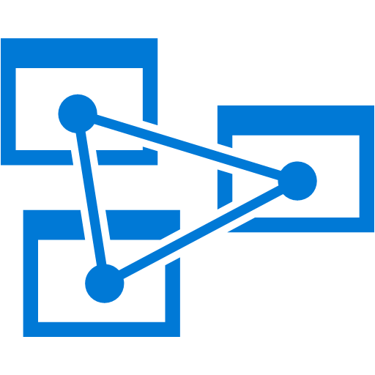
Preferred solution
Dashboards and reporting
A more cost-effective option for serving summary data for business analysts to use from Power BI is to use Azure Analysis Services. This eliminates having to have a dedicated Databricks cluster running at all times for reporting and analysis.
Your data is stored in a tabular semantic data model, which you populate by writing to it during stream processing using rolling aggregates over a time window, or by batch processing on a schedule using an Azure Databricks job or an orchestration service like Azure Data Factory.
Notes:
Option 2: Additional service and synchronization required, but lower cost option:
A more cost-effective approach to reporting is to store the summary (gold) table data in Azure Analysis Services, which you connect to from Power BI. This eliminates having to have a dedicated Databricks cluster running at all times for reporting and analysis. Azure Analysis Services is a fully managed platform as a service (PaaS) for storing your data in a tabular semantic data model. You will need to synchronize the data to your semantic models in Azure Analysis Services to keep your dashboard and reports up-to-date. This can be done as an extra step during stream processing, using rolling aggregates over a time window, or by batch processing on a schedule, using an Azure Databricks job or an orchestration service like Azure Data Factory.

